Slide 1




Structure Mapping for Transferability of Causal Models
Purva Pruthi
University of Massachusetts Amherst
ppruthi@umass.edu
Xiaoyu Lu
Amazon
Cambridge, UK
luxiaoyu@amazon.com
Javier González
Microsoft
Cambridge, UK Gonzalez.Javier@microsoft.com
Madalina Fiterau
University of Massachusetts
Amherst
mfiterau@cs.umass.edu
ICML 2020 workshop on Inductive Biases, Invariances and Generalization in RL (BIG)
Notes:
Hi everyone,
I am Purva Pruthi. I am going to talk about our work on “Structure Mapping for Transferability of Causal Models”. This is joint work with Xiaoyu Lu, Javier Gonzalez and Madalina Fiterau.

Slide 2


Reinforcement Learning and Causal Models
Role of Abstract Causal Knowledge
Human beings use abstract causal concepts to transfer knowledge in similar domains [1].
Learning of explicit causal dynamics model provides advantage of re-using the causal knowledge to transfer to the variations of the environment.
Object-oriented representation attributes effects of different objects to the object’s characteristics rather than it’s specific location in the state space [2].
[1] Dolan, R. J. and Dayan, P. Goals and habits in the brain. Neuron, 80(2):312–325, 2013. [2] Diuk, C., Cohen, A., and Littman, M. L. An object-oriented representation for efficient reinforcement learning. In Proceedings of the 25th international conference on Machine Learning, pp. 240–247, 2008
Notes:
Causal Knowledge plays a crucial role in every-day decision making. We construct rich causal models of objects around us and use them to transfer our knowledge to objects which behave similarly. For example, to open a door, if we have used a door knob and later if we interact with a door handle, we will categorize these differently looking objects in the same category based on their causal property which is to open the door.
In this work, we focus on learning an explicit causal dynamics model which provides an advantage of re-using causal knowledge to transfer to the variations of the environment.
We also use object-oriented representation which provides an efficient way of modeling an environment. ﻿

Slide 3
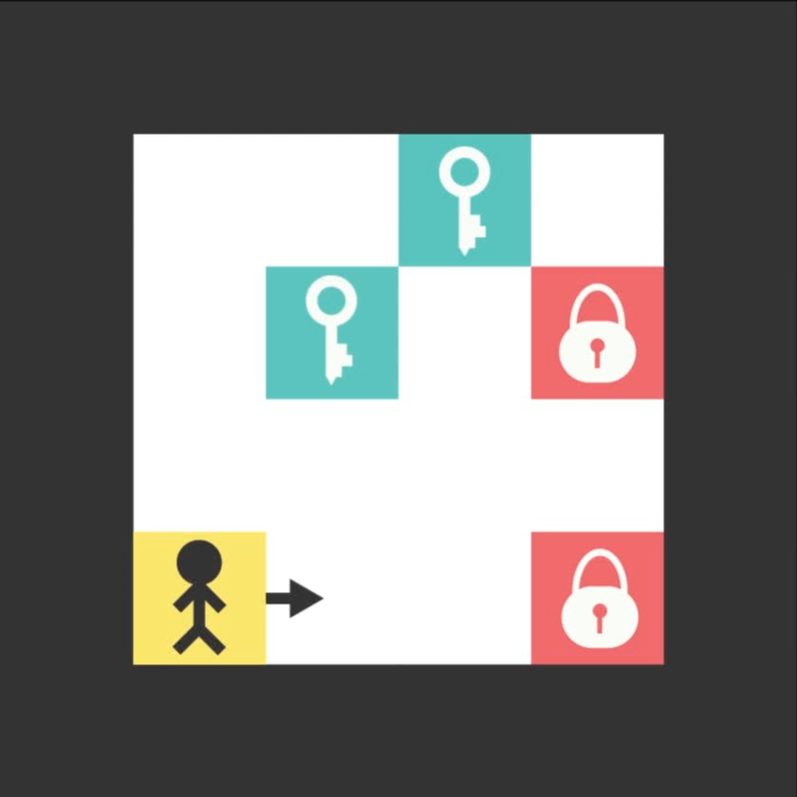

Toy Environment: Triggers [3]
Proof of Concept Environment
Figure 2 (a): Source Environment
Figure 2 (b): Target Environment
[3] Ferret, J., Marinier, R., Geist, M., and Pietquin, O. Self attentional credit assignment for transfer in reinforcement learning, 2019
Notes:
We use grid world based toy environment called “Triggers” for POC of our approach. The basic idea is for the agent to collect all the keys before opening each lock. Working of the environment is demonstrated in this animation. In target environment, underlying causal dynamics of the two environments remain the same while perceptual features (e.g. colors) of the objects are changed.

Slide 4
Causal Structure Mapping
A transfer learning framework
Assumptions
Source and Target environments have same causal dynamics model but different perceptual features.
Environments are discrete and deterministic.
In source environment, agent can experiment with the environment by taking random actions.
Experiments in target environment are limited.
Object-oriented representation is learned from visual-object reasoning modules and is already provided to us.
Objective
Transfer causal knowledge from source environment to the target environment with minimal possible interventions in the target environment.
Notes:
We make the following assumptions in our approach
- Source and Target environments have same causal dynamics model but different perceptual features. We simplified the difference in two environments for proof-of-concept.
- Environments are discrete and deterministic. This is to facilitate accurate learning of causal structures using score-based sl algorithm.
- In source environment, agent can experiment with the environment by taking random actions while experiments in target environment are limited. The goal is to learn near-perfect causal model and re-use the it in the target environment.
- Object-oriented representation is learned from visual-object reasoning modules in an unsupervised manner and is already provided to us, as our focus is more on structure learning rather than object detection.
Transfer knowledge from source environment to the target environment with minimal possible interventions in target environment and learn an optimal policy for target.

Slide 5
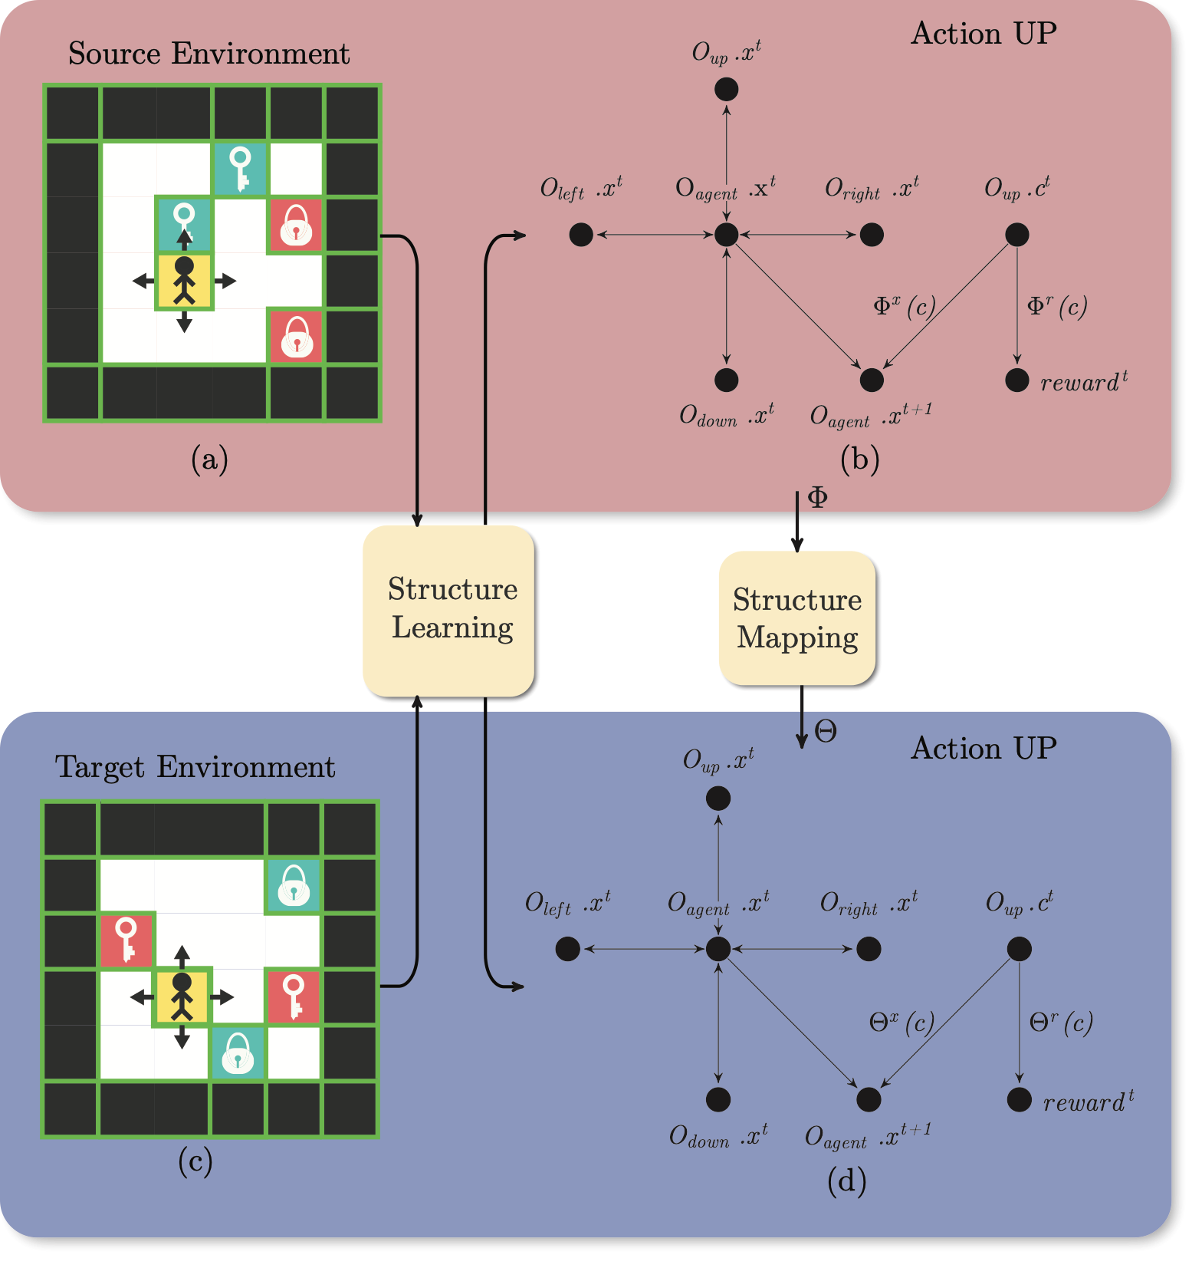
Approach
Structure Learning and Structure Mapping
Figure 3: High-level schematic diagram to illustrate the overall approach for transfer learning
Notes:
Our approach can be summarized in this flow chart.
Obtain object-oriented representation for the environment. In figure (a), we represent each object by its x,y position and color. We collect data from source environment by taking random actions. Using structure learning module, we learn causal structure for each action. Two sided arrows represent spatial relationship between the xy —position of agent and its nbrs. The most important causal dependency is between color of up nor and future x-pos of agent and future reward.
In target environment, we don’t learn explicitly the structure. Instead, we use structure mapping algorithm to transfer causal knowledge.

Slide 6
Structure Learning in Object Oriented MDPs
Continuous Optimization for structure learning [4][5]
Objective: Learn a DAG $G^{a}(Φ)$ by learning $f=(f_{1},f_{2},f_{3}…f_{d})$.
We assume that $f_{j}$ is a function approximated by neural networks using the parameters $Φ_{j}$.
$W(f)=W(f_{1},f_{2}…f_{d})∈R^{d×d}$ encodes the graph edges $G^{a}(Φ),i.e.[w(f)]_{kj}=∥\frac{∂f_{j}}{∂X_{k}}∥_{L_{2}}=0$ if $X_{k}∉Pa(X_{j})$.
$h(W(Φ))=tr(e^{W⋅W})-d$ encodes the acyclicity constraint.
$$\min_{Φ}L(Φ)=\frac{1}{n}\overset{d}{\underset{j=1}{∑}}l(x_{j},f(X,Φ_{j}))subjecttoh(W(Φ))=0$$
[4] Zheng, X., Aragam, B., Ravikumar, P., and Xing, E. P. DAGs with NO TEARS: Continuous Optimization for Structure Learning. In Advances in Neural Information Processing Systems, 2018.
[5] Zheng, X., Dan, C., Aragam, B., Ravikumar, P., and Xing, E. P. Learning sparse nonparametric DAGs. In International Conference on Artificial Intelligence and Statistics, 2020.
Notes:
-To learn the structure from state-transition pairs, we use continuous optimization for structure learning techniques developed by Jheng et al. Overall idea is to use score-based structure learning algorithm and encode the acyclicity constraint for DAGs as a continuous function which allows efficient search mechanism in the space of DAGs.
- We assume that the dependencies encoded by DAG represent direct causal dependencies. This assumption is reasonable in our context because we discover the causal graph by performing interventions (random policy) in the environment rather than by using observational data.

Slide 7
Structure Mapping from Source to Target
Structure Mapping Algorithm
Initially, start with assumption that two causal structures are same in the source domain and target domain.
Take limited number of random actions in target.
If the state prediction is wrong in the target domain, then:
Categorize objects in the same group if causal behaviors are the same.
Predict state transitions and reward function using mapped attributes.
Target object attributes (with the same transition parameters)
Source object attributes
Match
Notes:
In our structure mapping algorithm. We start with the learnt causal structure from source environment. We take limited number of random actions in the target environment, Wherever the prediction of dynamics model goes wrong, we map the attributes of objects in those instances to the objects in source environment with same transition parameters. The idea is to categorize objects in the same group if causal behaviors are the same. We then predict the state transitions using mapped attributes.

Slide 8
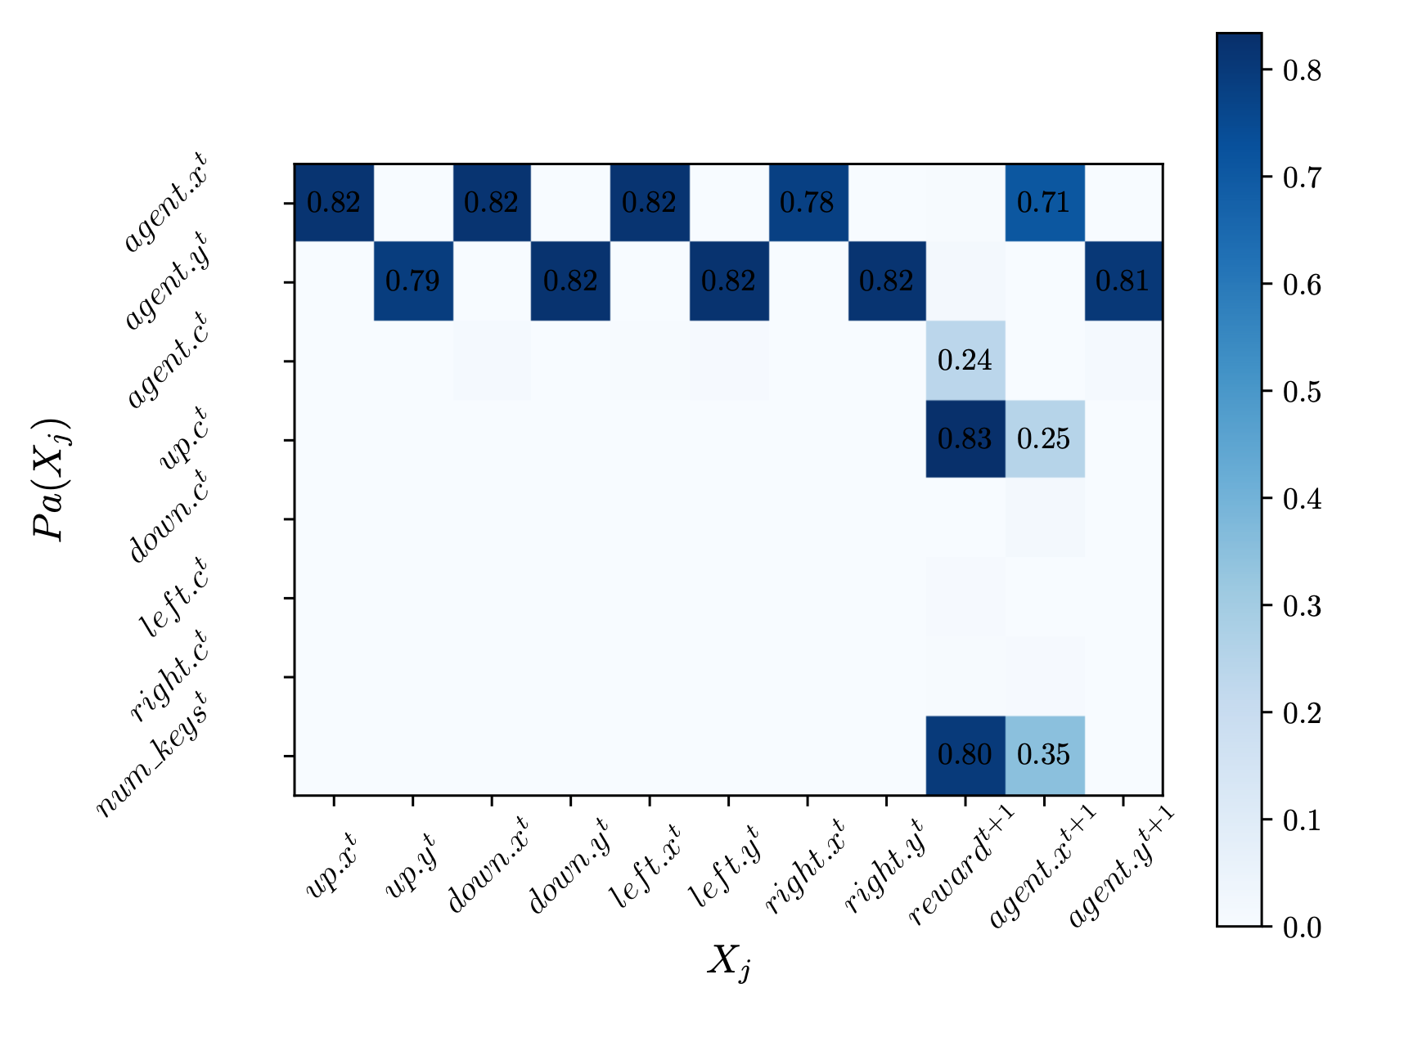
Experimental Evaluation
Structure Learning
Figure 3: $L_{2}$ norm of weight values for learned bayesian graph $G^{up}$ for action ${}^{′}UP^{′}$. Attributes on y-axis are potential parents (causes) of the corresponding $j_{th}$ attribute on x-axis ($X_{j}$), with parameters j . Positive values of weights indicate edge between parents and children.
Notes:
The key insight from the learned structure is the relationship between future reward and number of keys present in the environment., color of the ‘UP’ neighbor. Also next x- position of agent is dependent on the color of the up neighbor, as we expected.
Other dependencies which are captured are the spatial relationships between the agent’s x-y position and the neighbors.
Similar adjacency matrix are learned for the other actions.

Slide 9
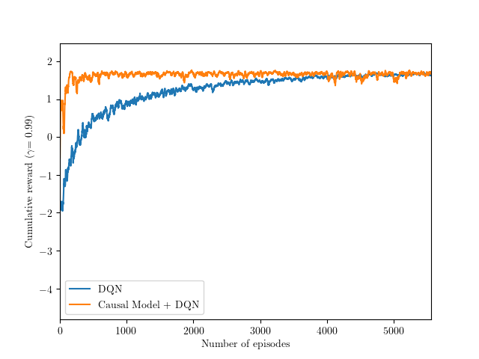
Experimental Evaluation
Causal Dynamics Model Based Planning
Less than 50% of the random actions were taken by DQN with causal model based planning as compared to DQN.
Figure 4: Planning using Causal-Dynamics Model
Notes:
This graph shows the performance results using causal model based planning compared to using purely model based approach DQN. We can observe the similar performance of the two models while causal model based planning requires 50% less number of interventions with the environment.

Slide 10
Future Work
Conclusion and Discussion
Evaluate of structure mapping in real-world environments.
Learn object-oriented representation for complex domains.
Learn distributed representations (e.g. deep embeddings) for attributes.
Extend to environments with continuous state and action spaces.
Limit the number of interventions and use of largely available observational data.
Notes:
This is still a work in progress. There are many interesting future directions for this work including learning distributed representations for attributes using neural-network based visual reasoning modules and extending it to environments with continuous state and action spaces.

Slide 11
Thank You!
Purva Pruthi
ppruthi@umass.edu
Xiaoyu Lu
luxiaoyu@amazon.com
Javier González
Gonzalez.Javier@microsoft.com
Madalina Fiterau
mfiterau@cs.umass.edu

